Slide 1



Need Statement
Design an automatic machine for efficient cleaning that can be used by organizations hosting large scale events

Slide 2

Introduction
Automatic cleaning machines are a revolutionary new solution for organizations that host large scale events. These machines are designed to autonomously navigate through a space and effectively clean a variety of surfaces, saving time and labor while improving the overall cleanliness of the event venue. The prototype presented in this document represents the latest iteration of this technology, incorporating feedback from previous models and incorporating new features to make it even more efficient and effective. This machine has the potential to revolutionize the way that events are cleaned, making it easier for organizations to keep their spaces clean and welcoming for their attendees.

Slide 3

Problem Statement of Project
“Design an automatic machine for efficient cleaning which can be operated using mobile phones. Cost of the machine should range between Rs.31,600 to Rs.37,350. The materials used should be corrosion-resistant and long-lasting. The machine should power using rechargeable batteries.”

Slide 4

Literature Review
1) Based on the weight of the suction pump in the vacuum cleaner, mop, sensors, etc.; the weight of the machine should be about 80-100 kilograms.
2) The run-time of the machine should be appreciably convenient so that it operates in the duration of 90 – 100 minutes.
3) The machine parts should be made of non-corrosive metals and the mop/broom should be made of _{durable synthetic fibers.}
4)The body of the machine should be made of materials having self-cleaning and anti-bacterial _{properties.}
5) The cleaning mop/broom should have a plano-convex shape so that it covers curved and sharp corners and edges efficiently.

Slide 5
Literature Review
6)The cleaning machine can be connected to android/i-phone(s); it can be operated with the help of voice assistants like Google Home and Amazon Alexa.
7) Batteries are rechargeable; a suitable battery adapter needs to be provided.
8) The machine has sensors that detects obstacles and navigates around the place that is to be cleaned; a gyroscopic motion sensor mechanism that runs on light-powered rotations to detect objects in its path and thus navigate accordingly should be instilled.
9) The machine should have a warranty of atleast 2 years.

Slide 6

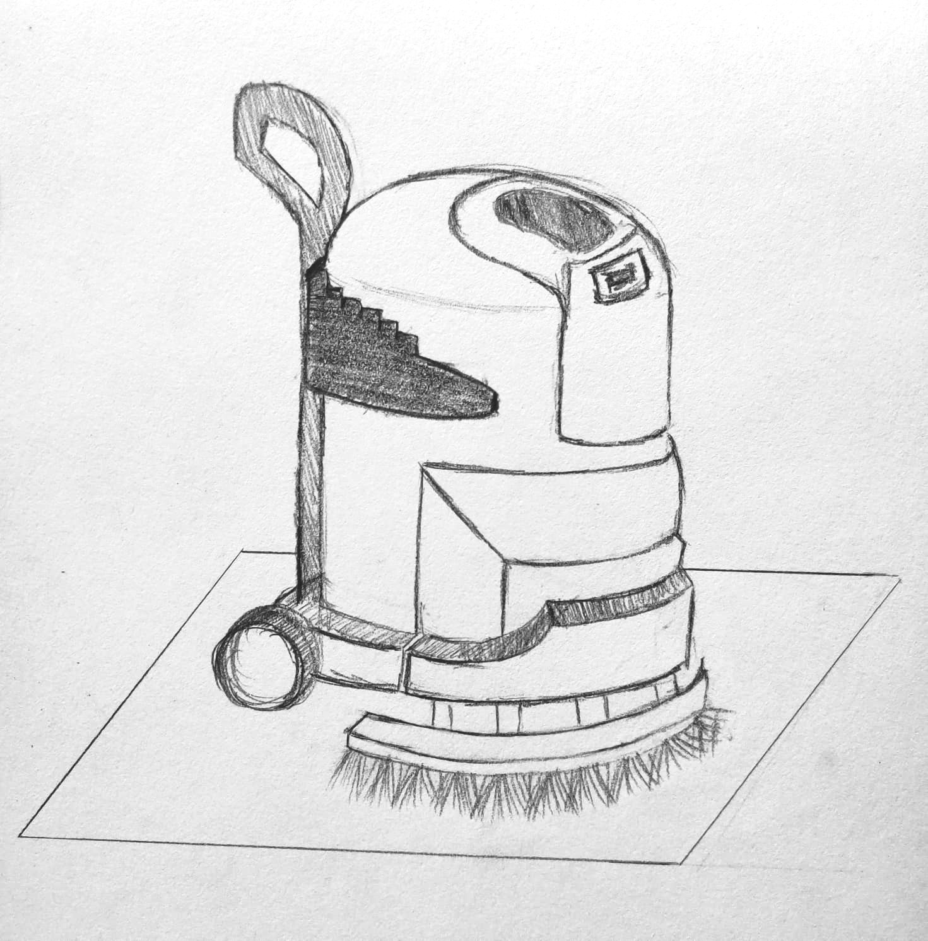
Preliminary Design (Sketch)
Power Button
Cleaning solution tank
100 cm
Semicircular mop
(arc length 90cm)
120 cm

Slide 7
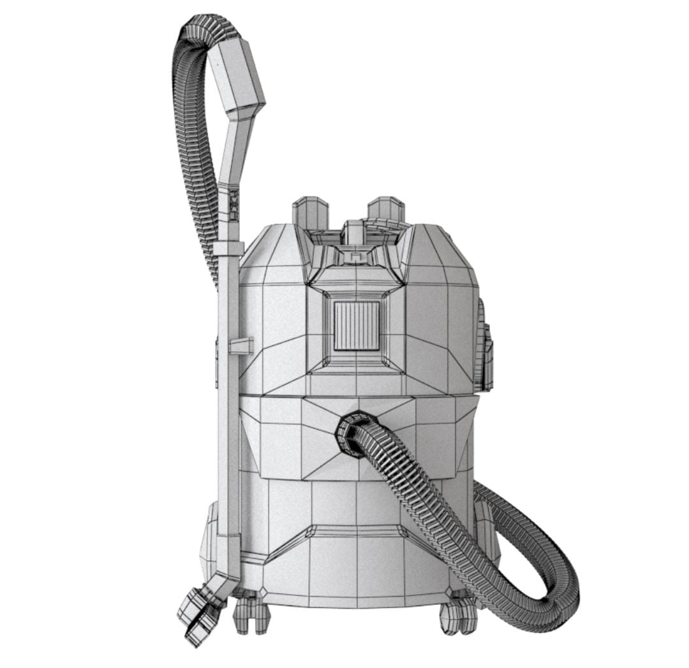
Preliminary Design (Alternate version)
Dust collector

Slide 8
List of Components
Nano-sized titanium dioxide and zinc oxide body
Stainless/galvanized steel or aluminium oxide metal parts
Suction pump (vacuum cleaner)
Cleaning mop made of long-lasting synthetic fibers
Semicircular chassis to mount the mop/broom
Bluetooth USB dongle
Batteries
Battery Adapter
Gyroscopic motion sensors

Slide 9
References
https://www.researchgate.net
https://iopscience.iop.org
https://www.ijert.org
https://www.ijraset.com
https://www.academia.edu
https://www.fortunebusinessinsights.com

Slide 10
Role & Contribution of each member
NAME | DIVISION | ROLL NUMBER | ROLE PLAYED
Vedika Surve | P-2 | 16014022084 | Research(content)
Sanjana Somani | P-2 | 16014022114 | Research(content)
Aditi Chaudhari | P-3 | 16010322004 | PPT designing
Shambhavi Parab | P-3 | 16010322039 | Prototype designing
Chandana Galgali | P-3 | 16010422234 | PPT designing
Samyukta Nair | P-5 | 16010122236 | Prototype designing

